Slide 1

Components of Apache Spark 2

Slide 2
Components of Apache Spark
Spark Core
Spark SQL
Spark Streaming
MLlib
GraphX

Slide 3
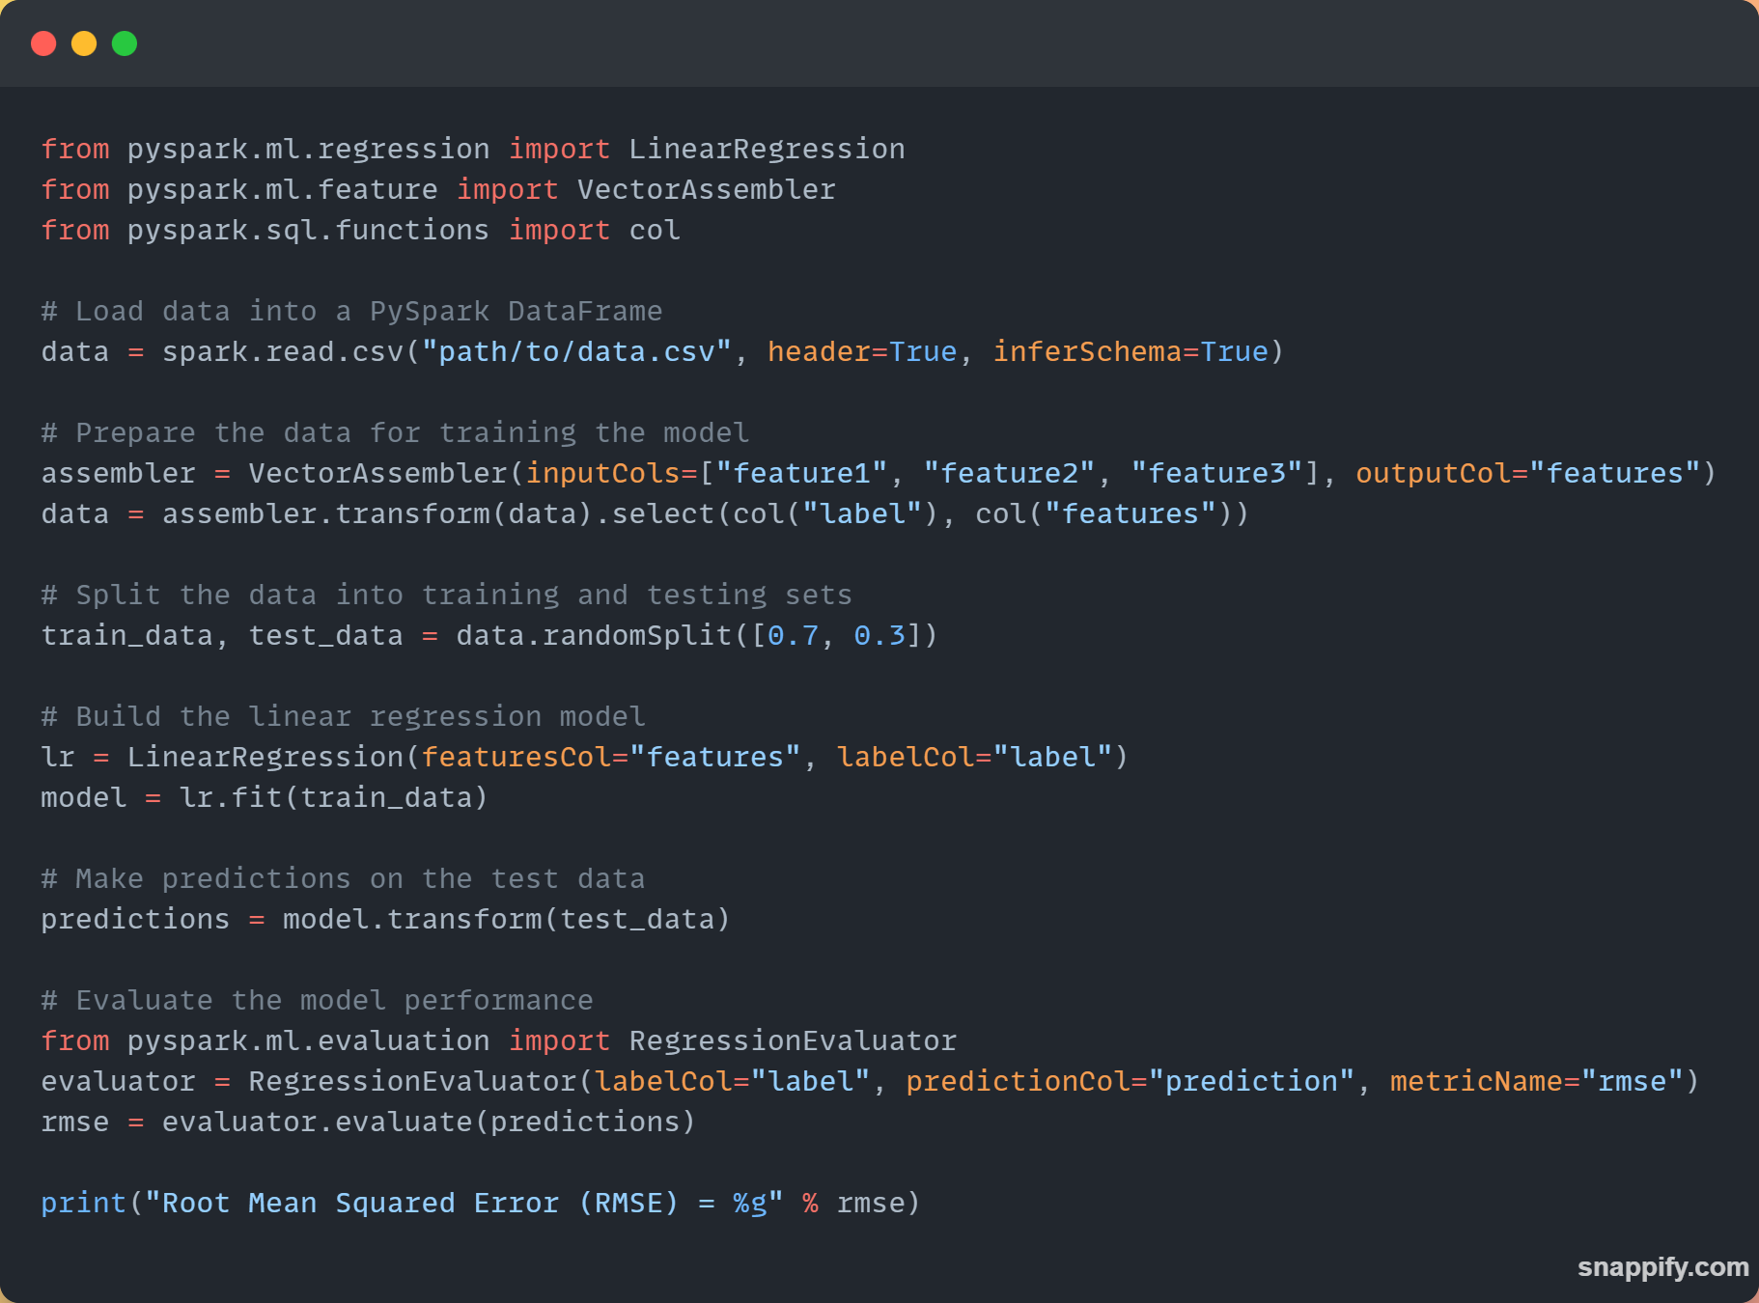
MLlib
A machine learning library in PySpark
Wide range of machine learning algorithms
Supports Batch and streaming
Various data processing techniques
Tools for model evaluation
Supports various data formats
Integrates with other PySpark Components (SQL,GraphX and streaming)

Slide 4
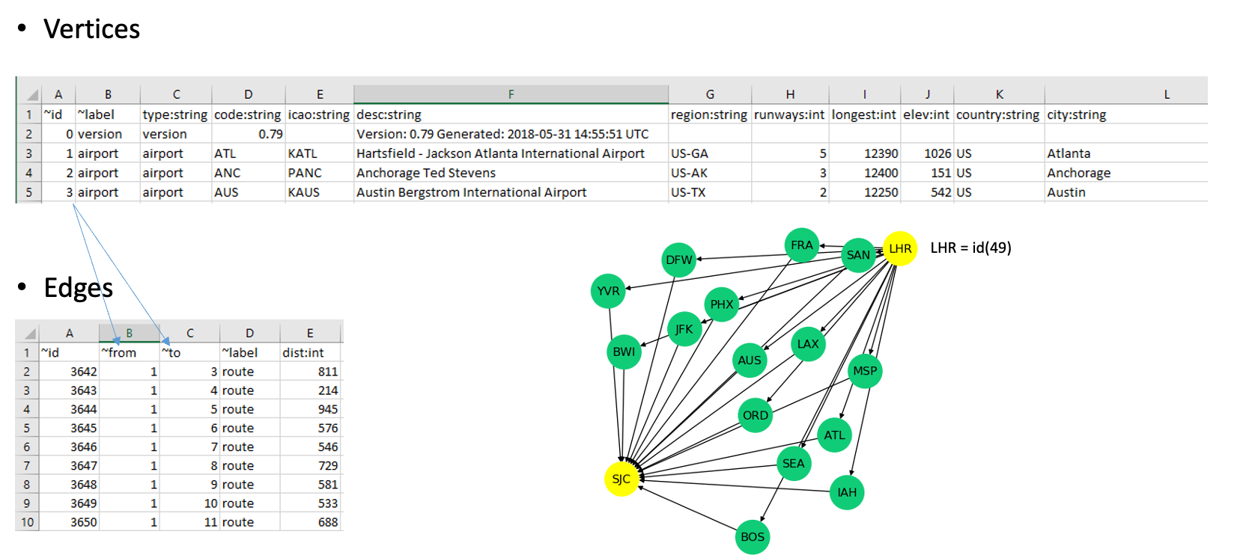
Graph example

Slide 5
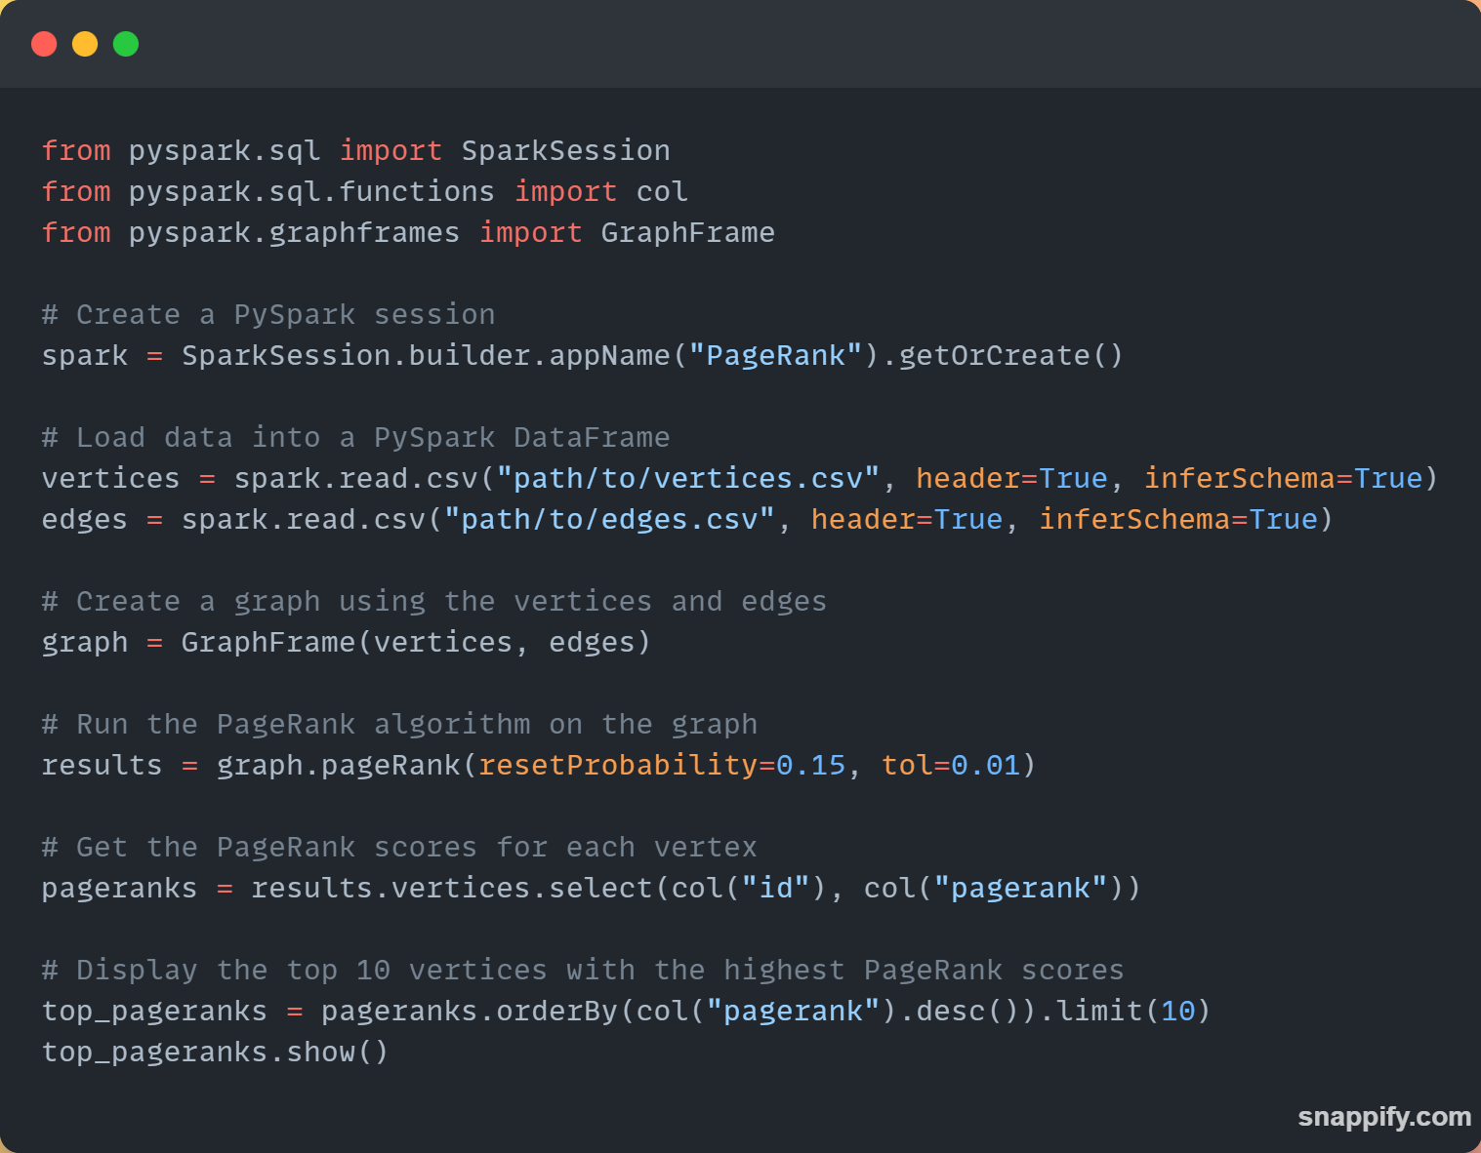
GraphX
Allows for analysis of graph structured data
Unified programing model, for both graph and relational operations
Supports both directed and undirected graphs
Enables creation and manipulation of graphs

Slide 6
GraphX
Allows for analysis of graph structured data
Provides built-in graph algorithms
Allows users to define own graphs
Integrates with other Spark Components such as MLlib SQL and streaming

Slide 7
Next…

